Slide 1
Neural Networks
Matthias Schonlau, Ph.D. ©

Slide 2
Overview
Vanishing gradients
Weight initialization
Stochastic gradient descent
Dropout
regularization

Slide 3
Vanishing and Exploding Gradients
For neural networks with many hidden layers, the numerical computations may suffer from a vanishing or exploding gradients problem

Slide 4

Vanishing and Exploding Gradients
Consider one path through a neural network with three hidden layers
where is the derivative of the activation function

Slide 5
Vanishing and Exploding Gradients
If the chain is long enough, and the derivative is small (<1), the product will “vanish” (numerically zero)
Likewise, if the derivative is large (>1), the product will “explode”. This is less common.
The problem does not arise for ReLU as its derivative is always 0 or 1. (However, 0 leads to the “dying” node problem)

Slide 6
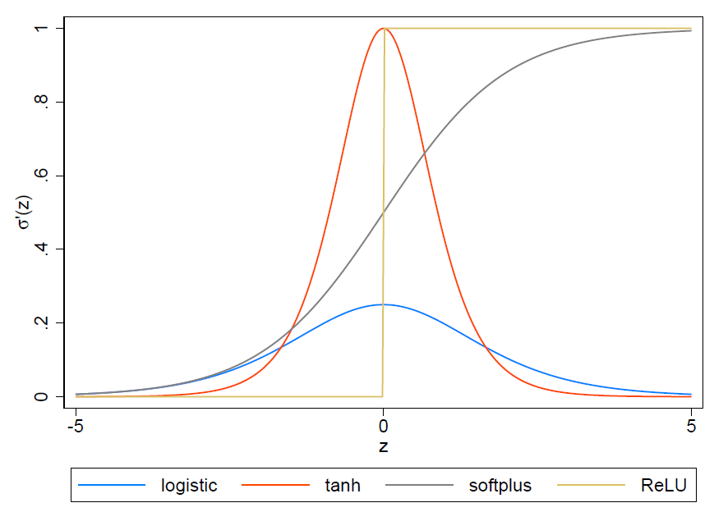
Activation Function Derivatives
For logistic and tanh, very large or very small values for z make the vanishing gradient problem worse

Slide 7
Weight initialization
Neural networks initialize with random weights
Neural networks are sensitive to weight initialization
One can show that the variance increases from layer to layer by a factor of fan_{in} :
where fan_{in} is the number of arrows (except the intercept arrow) coming into z (calculation details in book)
Large variances are a problem because the probability of very large and very small values increases

Slide 8
Weight initialization
For many activation functions (not: ReLU) large values have very small slopes
This creates vanishing gradients
To compensate, for symmetrical activation functions initialize weights as follows:
This is called the Glorot/ Xavier initialization
ReLU is not symmetrical. A slightly different factor is used (see book)
where

Slide 9
Stochastic gradient descent
We have assumed that forward and backward passes use all the observations
We can split the data into random subsets called “batches” or “mini-batches”
One iteration refers to a forward/backward pass of one batch. The next iteration uses the next batch, until all batches have been used
One forward and backward pass of all observations is called one epoch
i.e. one forward/backward pass with all batches, one batch at a time

Slide 10
Stochastic gradient descent
Gradient descent on a random subset is called stochastic gradient descent
Pros: Using batches makes the computations faster and requires less memory
Cons: The smaller the batch, the less accurate the estimate of the gradient will be. If the surface area is shallow, a variable gradient descent may have a hard time finding the minimum
Therefore, we look for a compromise: large enough to allow for effective gradient descent, but as small as possible
Famous (old) LeCun tweet:
“Friends don’t let friends use mini-batches larger than 32”
(This is just a ballpark value)

Slide 11
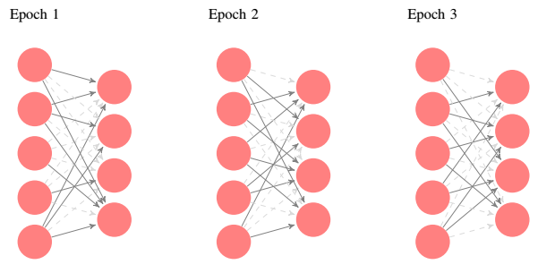
Dropout
Dropout refers to removing edges with a pre-specified probability during an epoch
This encourages learning redundancies
Dropout occurs only during training, not during testing
Dropout is a (unusual) form of regularization
To build redundancies, weights need to be distributed over more nodes, often leading to smaller weights

Slide 12
Weight-decay Regularization
The shrinking-type regularization is also called “weight decay”
L2 regularization:
where E is the error and alpha is a tuning parameter
The factor 0.5 is convenient, but could be absorbed into alpha
This is the same regularization as in ridge regression

Slide 13
Weight-decay Regularization
The partial derivative of the error with respect to weight w_{i}
Alpha becomes a tuning parameter
We weight update is changed accordingly:

Slide 14
Practical issues
Variables should be standardized
E.g. into a range of 0/1
E.g. standardized to have mean=0, variance=1
neural networks are often difficult to fit
Convergence problems
Local minima

Slide 15
Example: predicting the value of a poker hand
Poker is a card game
There are 13 ranked cards in each of 4 suits for a total of 13*4=52 cards
Ranks: 2, 3, 4, 5, 6, 7, 8, 9, 10, jack, queen, king, ace
Suits: hearts, clubs, diamonds, spades
Each player gets 5 cards
The value of any set of 5 cards shown on the next page

Slide 16
Value of a poker hand
Value | explanation | Additional explanations
0 | Nothing
1 | One pair | Two cards of equal rank
2 | Two pairs
3 | Three of a kind | Three cards of equal rank
4 | Straight | Five cards in sequence, without gaps
5 | Flush | Five cards in the same suit
6 | Full House | Three cards of equal rank and a pair
7 | 4 of a kind | Four cards of equal rank
8 | Straight flush | Straight In the same suit
9 | Royal flush | 10, Jack, Queen, King, ace in the same suit

Slide 17
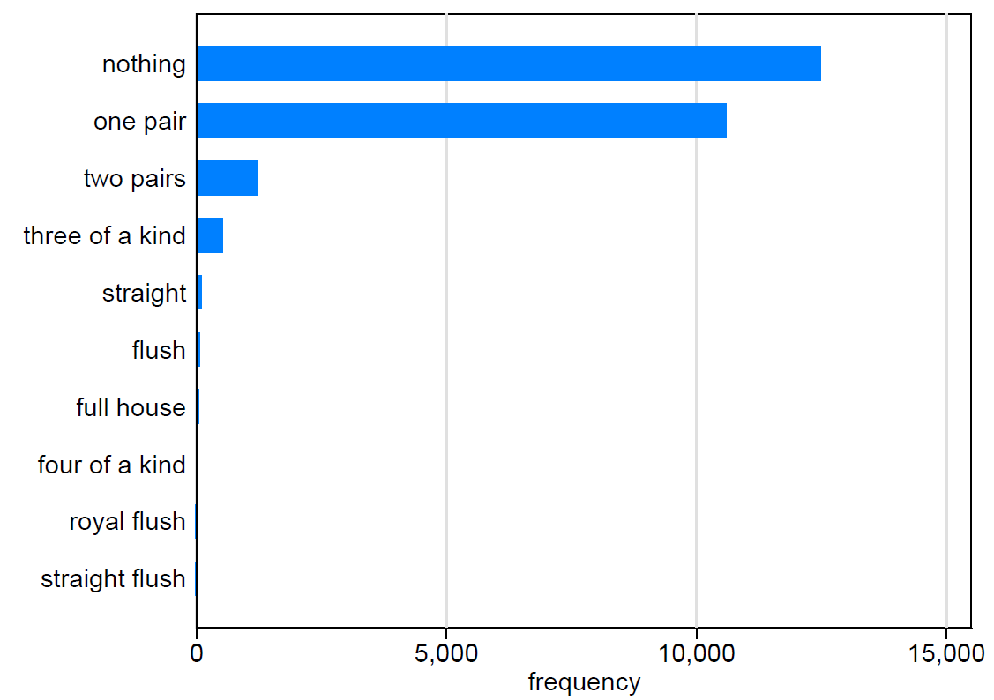
Bar chart of the outcome classes
Highly uneven distribution

Slide 18
Splitting into training/validation/test data
25,010 (training+validation) obs , 1,000,000 test obs
We split the non-test data into 75% training data and 25% validation data.
Because of the highly uneven distribution, we do so separately by outcome value
Split Royal flush obs 75/25
Split Straight flush obs 75/25
Split Four of a kind obs 75/25
…
This is called “stratification” (survey sampling), or “balancing” (in experimental design)

Slide 19
Splitting into training and validation data
Without stratification, there might be none of the 5 observations with value =9 (royal flush) in the validation data
Lack of validation data in one outcome means for that outcome no criterion can be computed
 | Training | Validation
Nothing | 9370 | 3123
One pair | 7949 | 2650
Two pairs | 905 | 301
Three of a kind | 385 | 128
Straight | 70 | 23
Flush | 41 | 13
Full House | 27 | 9
4 of a kind | 5 | 1
Straight flush | 4 | 1
Royal flush | 4 | 1

Slide 20
Tuning
Several tuning parameters: learning rate, alpha (regularization), number of layers, number of nodes within layer.
We employ a sequential strategy, one parameter at a time
First look for a reasonable learning rate

Slide 21
Tuning the learning rate
Alpha | Learning rate | Layer | macroF | Accuracy
0 | 0.01 | 100 | .430 | .962
0 | 0.001 | 100 | .268 | .732
0 | 0.1 | 100 | .130 | .533
0 | 0.2 | 100 | .082 | .517
The rows are sorted by macroF
We are primarily interested in macroF, but also list accuracy
“Layer=100” Means one hidden layer with 100 nodes
Conclusion: learning rate of 0.01 has the highest macroF

Slide 22
Tuning alpha (regularization)
Alpha | Learning rate | layer | macroF | accuracy
0 | .01 | 100 | .430 | .962
.001 | .01 | 100 | .418 | .951
.01 | .01 | 100 | .356 | .896
Alpha=0 has the highest macroF.
Corresponds to no regularization

Slide 23
Tuning the number of layers and nodes
Alpha | Learning rate | Layer | MacroF | Accuracy
0 | .01 | 100, 50,10 | .680 | .982
0 | .01 | 300, 100, 50, 10 | .664 | .995
0 | .01 | 1000, 300, 100, 50, 10 | .620 | .984
0 | .01 | 600, 300, 100, 50, 10 | .616 | .993
0 | .01 | 300, 50, 10 | .611 | .989
0 | .01 | 100 | .43 | .962
0 | .01 | 100 | .430 | .962
0 | .01 | 50, 10 | .412 | .859
0 | .01 | 300 | .366 | .948
0 | .01 | 10 | .303 | .550
Rows are sorted by macroF
A three-layer solution works best.

Slide 24
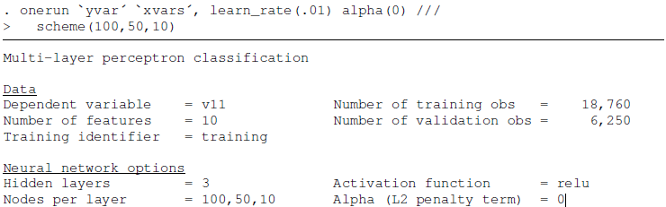
Prediction on the test data

Slide 25
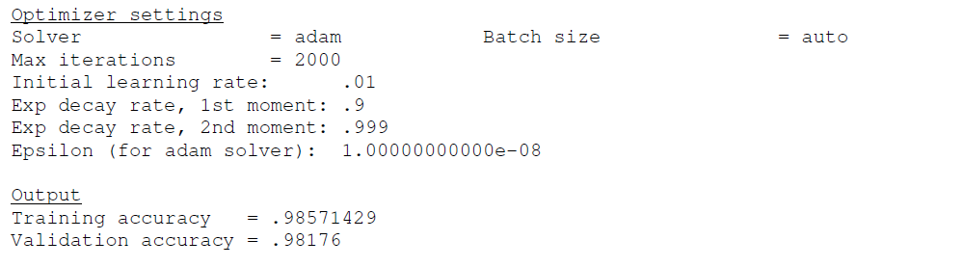
Prediction on the test data

Slide 26
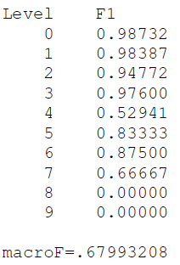
Prediction on the test data: results
Predictions for Level 8, 9 are incorrect (remember small sample size)
Therefore, macroF, the average F1, is not great
MicroF (not shown) is much better

Slide 27
R implementations
“Nnet”
Has only one hidden layer
Cannot handle many weights (=M*p)
e.g. For patient Joe data with a single neuron (M=1) there were 1200 weights; nnet refused
“Neuralnet”
Strict convergence criterion
Difficult to attain convergence

Slide 28
R Syntax of neural net
nn <- neuralnet(f, data=train,hidden=c(5,1),err.fct = "ce",linear.output=F)
Hidden=c(5,1) specifies two hidden layers
5 neurons in the first (lower) layer
1 neuron in the second (higher) layer
err.fct="ce" specifies the criterion to be cross-entropy
linear.output=F is needed for classification
apply the activation function instead of using the linear output
Act.fct=“logistic” is the default
algorithm = "rprop+“ (this is not backpropagation)
Learningrate = not required unless backpropagation is used

Slide 29
Patient Joe – proactive vs not
All x-variables are scaled to mean zero an variance 1
Optimizer method “adam” uses learning rate lr=0.001 by default
Python
Number of x-variables
from keras.models import Sequential
from keras.layers.core import Dense
nn_model = Sequential() # create model
nn_model.add(Dense(n_neurons, input_dim=1199, activation='relu')) # hidden layer
nn_model.add(Dense(1, activation='sigmoid')) # output layer
nn_model.compile(loss='binary_crossentropy', optimizer='adam', metrics=['accuracy'])
output = nn_model.fit(Xtrain, Ytrain, epochs=100, batch_size=1300)
Number of y-variables is 1 except for multi-class problems

Slide 30
Patient Joe: accuracy and loss
Accuracy/loss as a function of the number of nodes
Proactive vs not
1 hidden layer
100 epochs
test_acc= .715517 for 20 nodes

Slide 31
Patient Joe – proactive vs not
Adding a second hidden layer
To avoid optimizing over the number of neurons in both layers, I specified that the first layer has twice as many nodes as the second
This is not the only option, but if one layer has more neurons than it should be the first
from keras.models import Sequential
from keras.layers.core import Dense
nn_model = Sequential() # create model
nn_model.add(Dense(2*n_neurons, input_dim=1199, activation='relu')) # hidden layer
nn_model.add(Dense(n_neurons, activation='relu')) # 2nd hidden layer
nn_model.add(Dense(1, activation='sigmoid')) # output layer
nn_model.compile(loss='binary_crossentropy', optimizer='adam', metrics=['accuracy'])
output = nn_model.fit(Xtrain, Ytrain, epochs=100, batch_size=1300)

Slide 32
Patient Joe: accuracy and loss
Accuracy/loss as a function of the number of nodes
Proactive vs not
2 hidden layers
100 epochs
test_acc= .738506 for neuron=5
10 nodes in the first layer
5 nodes in the second layer

Slide 33
Patient Joe: without scaling
Proactive vs not
2 hidden layers
100 epochs
unscaled test_acc= .781609 for neuron=5
10 nodes in the first layer
5 nodes in the second layer
Surprisingly, unscaled test accuracy is higher
Explanation: Indicator variables do not require scaling. The only non-indicator variables is “number of words”. We know this is a key variable. By not scaling, we have inadvertently helped neural networks.

Slide 34
Deep learning
Neural networks have been around since the 1980’s and were not super-competitive
However, recently (~2009) neural networks have started to outperform all other learning algorithms
Started in image analysis
New name: “deep learning”
Usually, “deep learning” refers a neural network with
Multiple hidden layers
Large data set
The sudden success is probably due to the ability to handle larger data sets after some computational advances:
For image analysis, an additional pre-processing step was added reducing computational complexity
Running computations on a graphics chip made computations faster
This is a very active area of research and insight in the success of deep learning is preliminary

